Slide 1
Chapter 12 Visualization and Plotting
By
Hyung Jae (Chris) Chang
Troy University

Slide 2

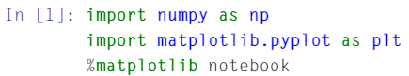
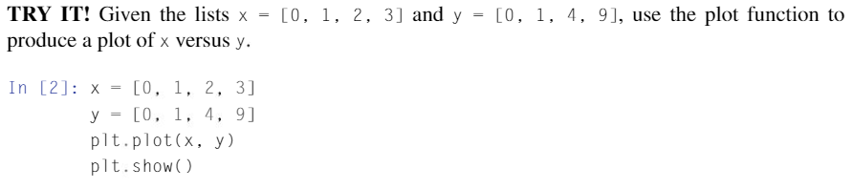
2D Plotting
matplotlib package is used for plotting data in Python.
Special feature only for Jupyter notebook!

Slide 3
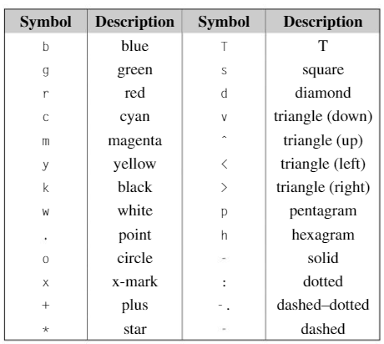
2D Plotting (cont.)
plt.plot() function connects each point.
plt.show() shows the figure.
Third argument can be added for plot() function, such as plot(x, y, “ro”) to specify the color and line style to be used in the plot.

Slide 4
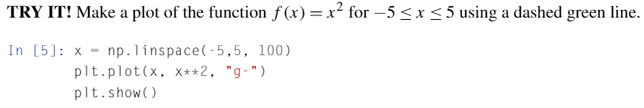
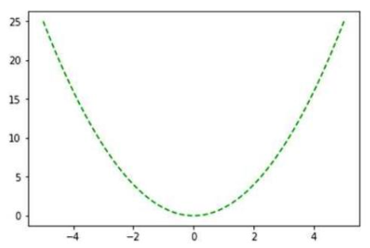
Example

Slide 5
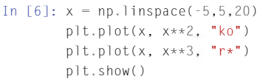
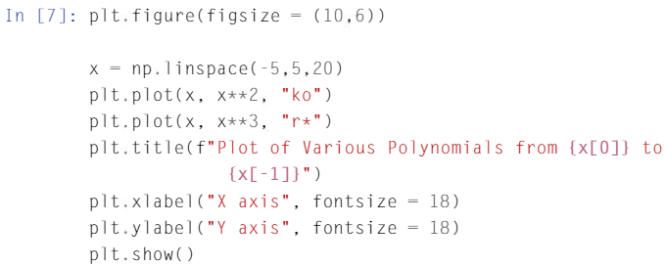
More Features for 2D Plotting
We can add in and plot more datasets within one figure.
We can add both title and axis labels.

Slide 6
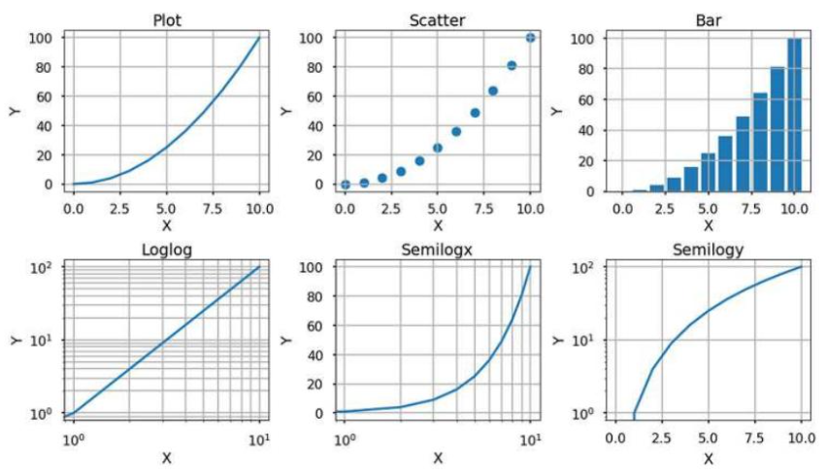
Table of Plots
subplot() function is used.
subplot() takes 3 inputs; the number of rows of plots, the number of columns of plots and designating which plot all calls to plotting functions should plot.
plt.suplot(2, 3, 1)
plt.suplot(2, 3, 4)

